Slide 1
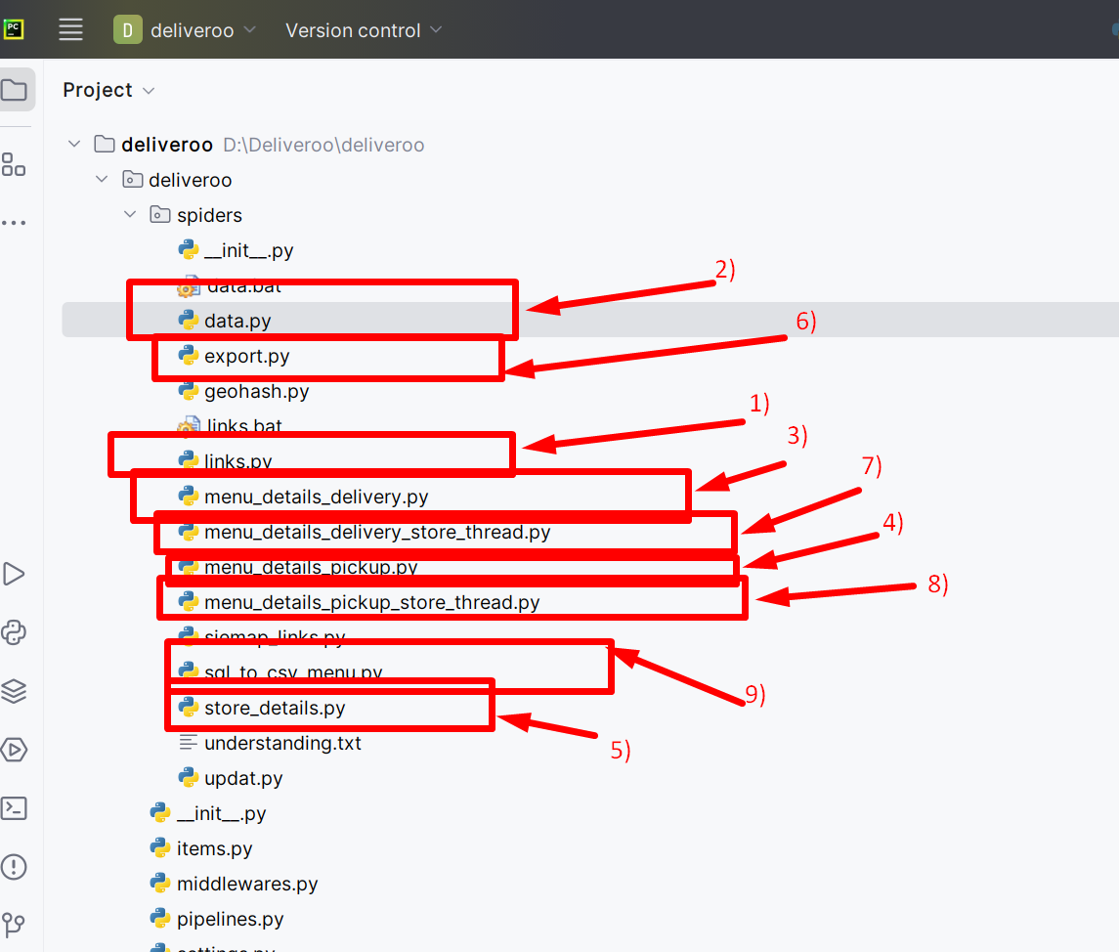
Deliveroo –HK-Py Files
Delivery Date : 5th and 20th

Slide 2
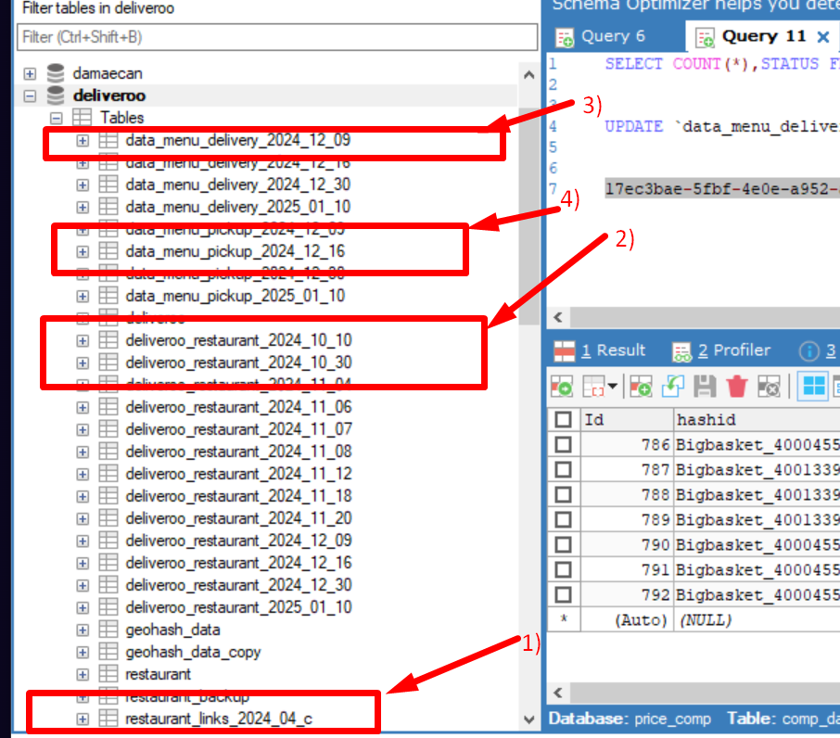
Database Tables:-

Slide 3
explanation for py files
1) links.py –Run this file to get all the links from sites using searching method
-> note: insert ignore query for previous to current table if current links count less then 12000 to 13000. before fire insert ignore query remove id in both table. -> Query: INSERT IGNORE INTO `current_restaurant_link_table` (SELECT * FROM ` previous_restaurant_link_table `)
2)Data.py- Run this file to get restaurant details from site
3)menu_details_delivery.py- Run this file to read pagesave and insert menu delivery data in sql
4)menu_details_pickup.py- Run this file to read pagesave and insert menu pickup data in sql
5)store_details.py-Run this file to get data of stores and store in database
UPDATE `deliveroo_restaurant_2025_02_05` SET promotions=0 WHERE promotions=1 AND promotion_tags_delivery ="“
Note: we need to run above query then after start our next steps
6)export.py –Run this file and export restaurant details file
7) menu_details_delivery_store_thread.py-Run this file to get data for store menu delivery method using request
8) menu_details_pickup_store_thread.py-Run this file to get data for store menu pickup method using request
9) sql_to_csv_menu.py- Run this file and export menu details file

Slide 4
explanation for Database and table
Database:-Deliveroo
Delivery Date : 5th and 20th (In month 2 time delivery 5th and 20th) There is 4 table for all the data
1) restaurant_links_{date}:-this table contains restaurant links which we get after run links.py
2) deliveroo_restaurant_{date}:-this table contains all restaurant data and store data which we get after run data.py and store_details.py
3) data_menu_delivery_{date}:- this table contains all delivery method’s menu data for store and restaurants
4) data_menu_pickup_{date}:- this table contains all pickup method’s menu data for store and restaurants Approx Count:-
restaurant data :-12600 – 12900
Menu data :- 1800000 -1900000

Slide 5
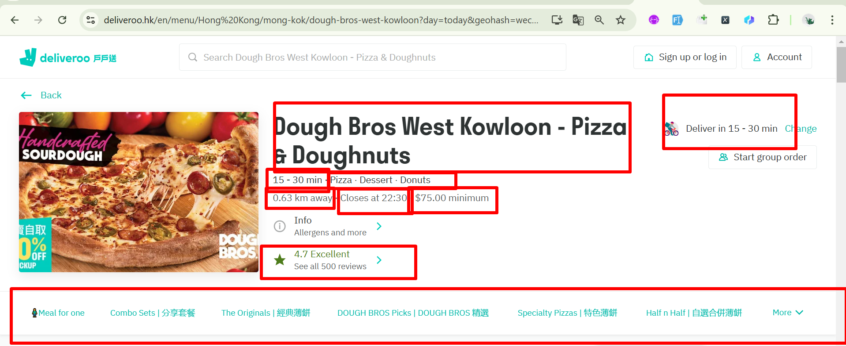
Required details from site for restaurant file https://deliveroo.hk/en/menu/Hong%20Kong/mong-kok/dough-bros-west-kowloon/?fulfillment_method=collection&day=today&geohash=wecnvyy25t0v&time=ASAP https://deliveroo.hk/en/menu/Hong%20Kong/mong-kok/dough-bros-west-kowloon/?day=today&geohash=wecnvyy25t0v&time=ASAP

Slide 6
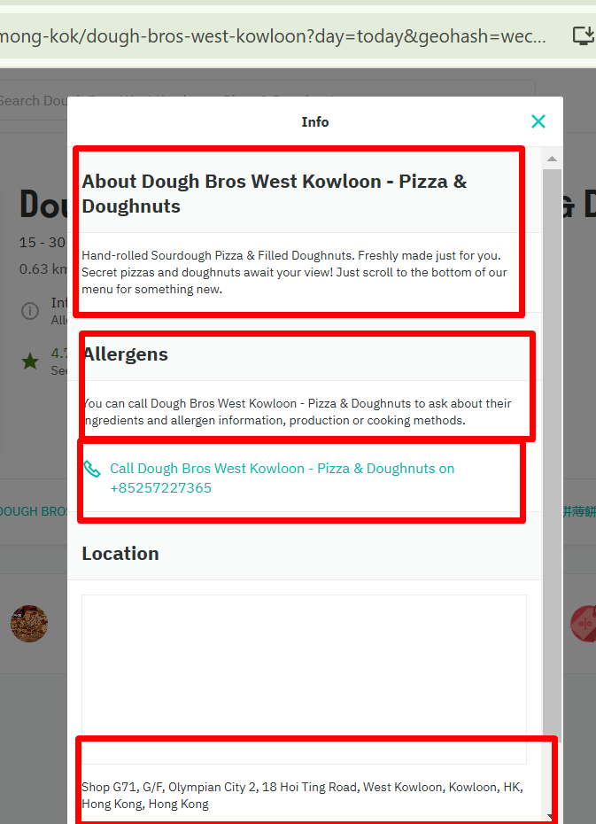

Slide 7
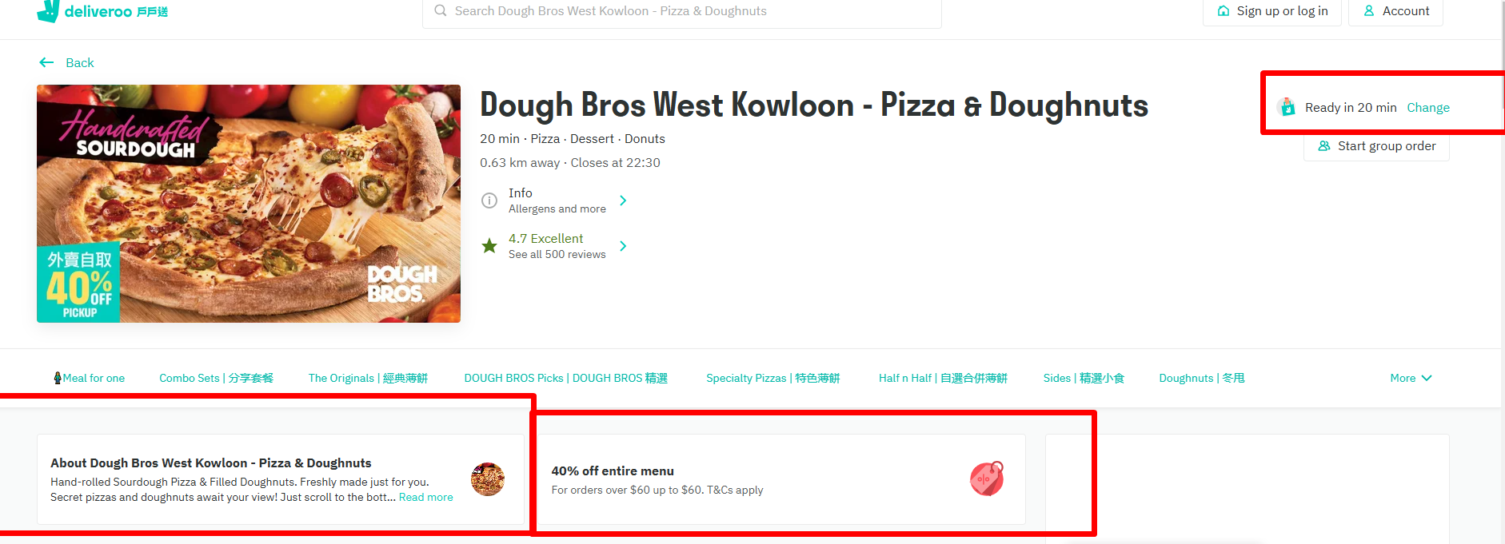

Slide 8
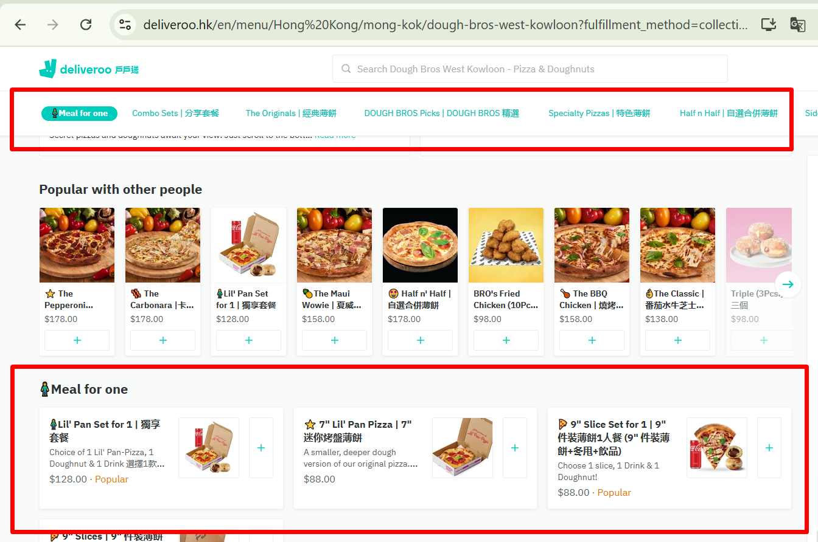
Require data from site for menu file

Slide 9
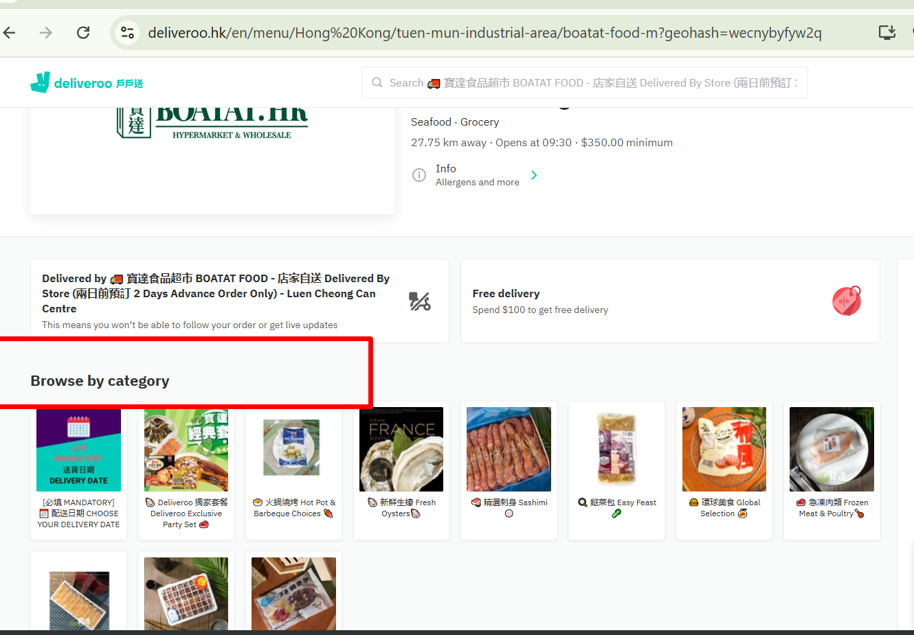
Exaple of store https://deliveroo.hk/en/menu/Hong%20Kong/tuen-mun-industrial-area/boatat-food-m?geohash=wecnybyfyw2q store will identify from “Browse By Category “

Slide 10
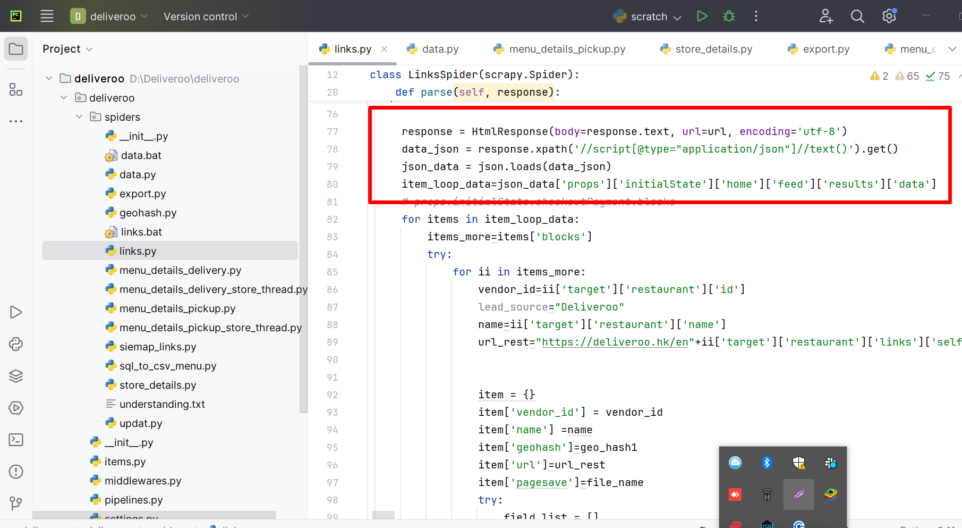
We will get links from this code

Slide 11
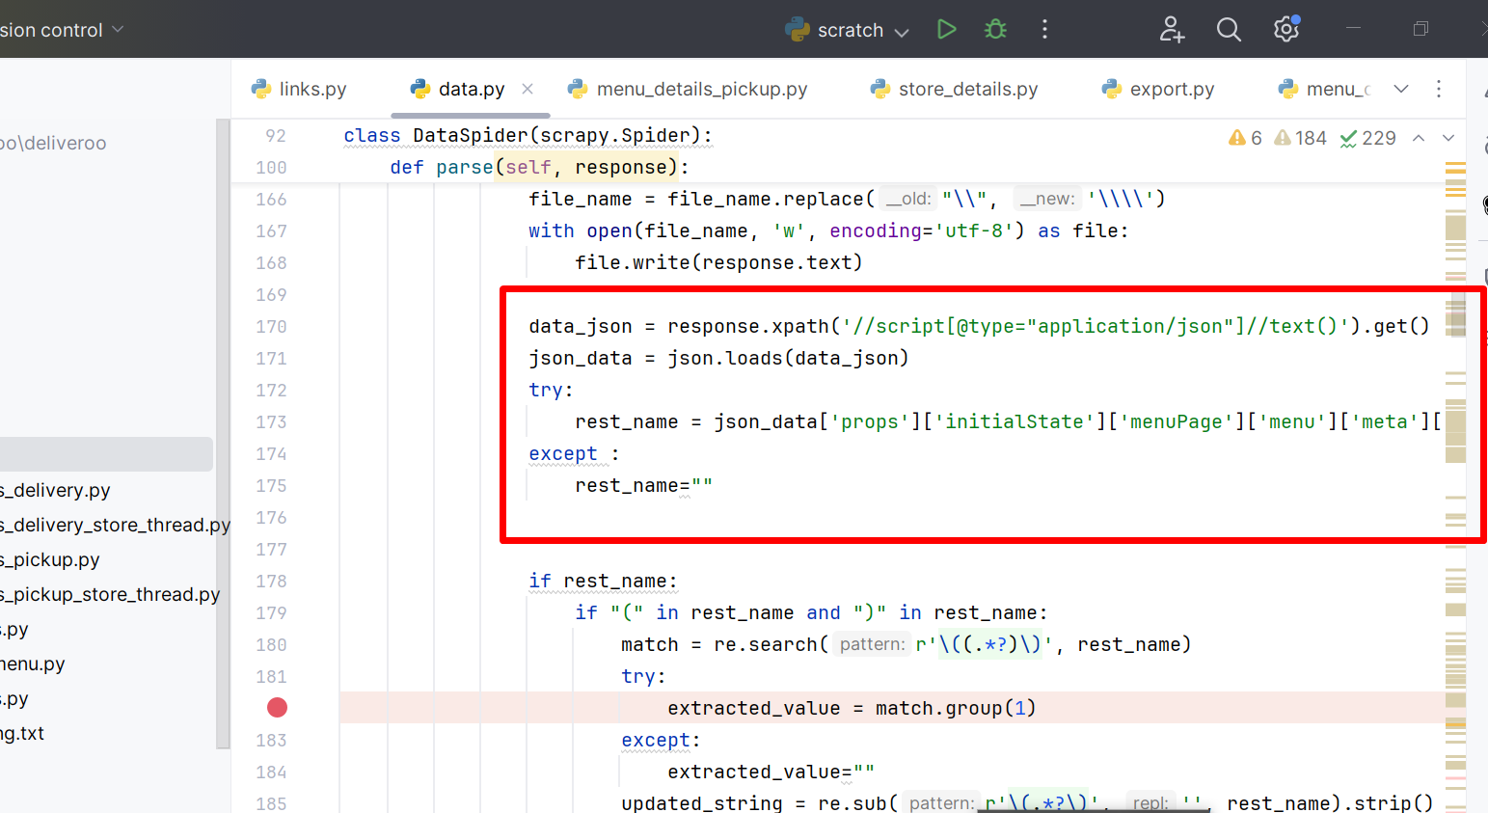
We get restaurant data from this code there is total 4 request in this file (data.py)

Slide 12
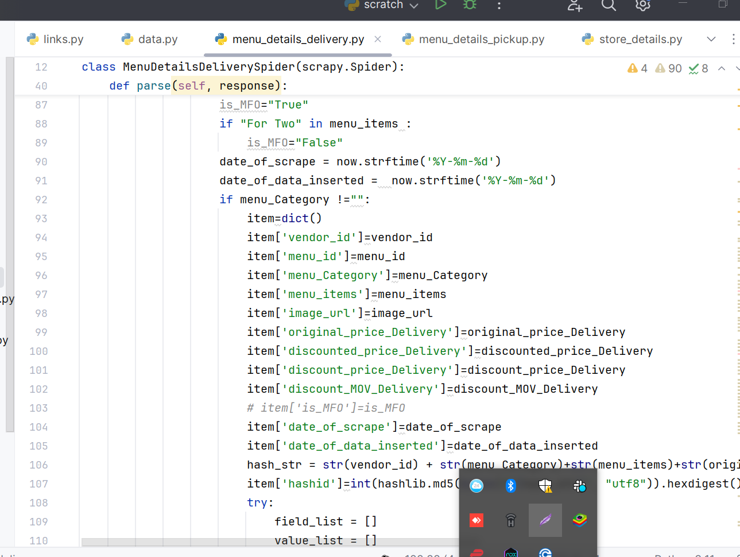
Using page read we will get menu data for delivery method(menu_details_delivery.py)

Slide 13
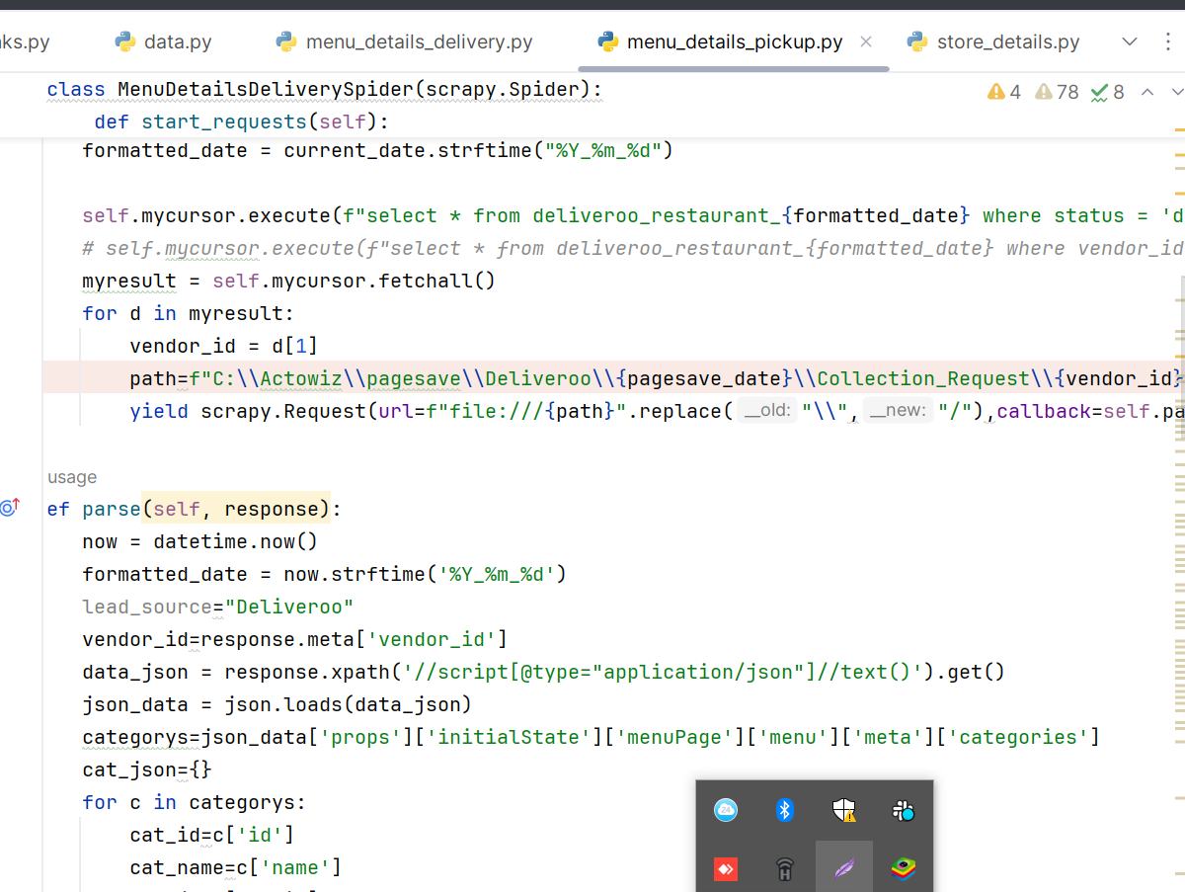
We will get menu data for pickup method using this py file (Menu_details_pickup.py)

Slide 14
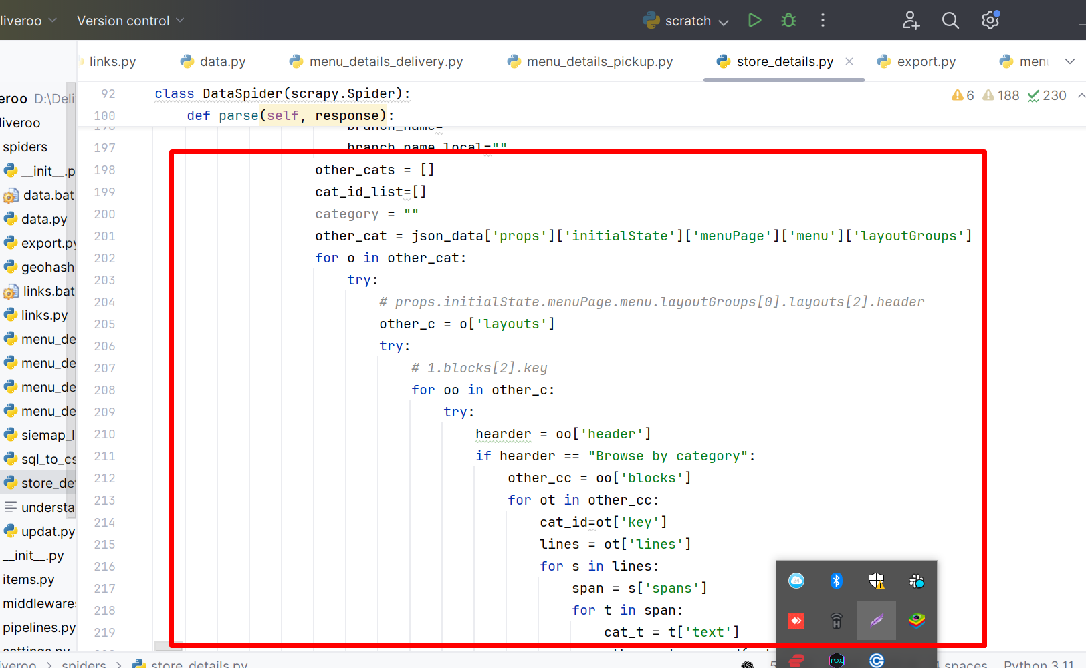
We will get store details from this code (store_details.py)

Slide 15
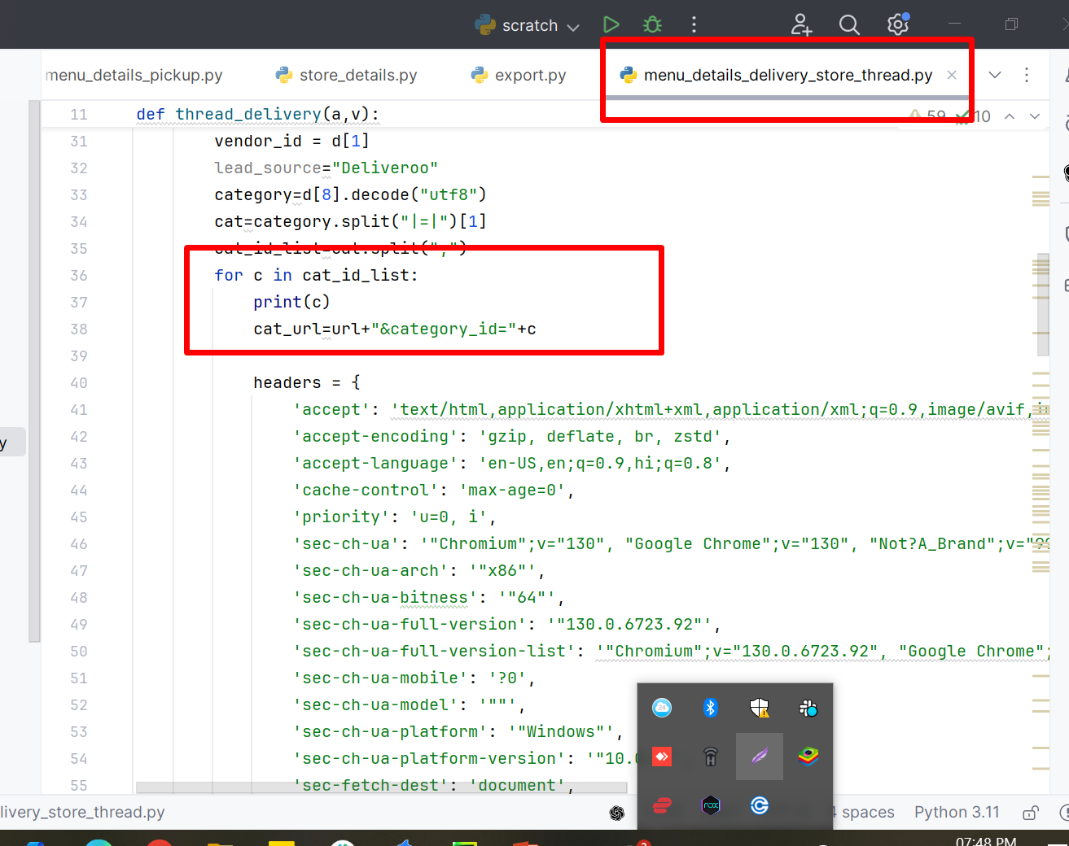
We hit the request to get menu details from store category delivery method

Slide 16
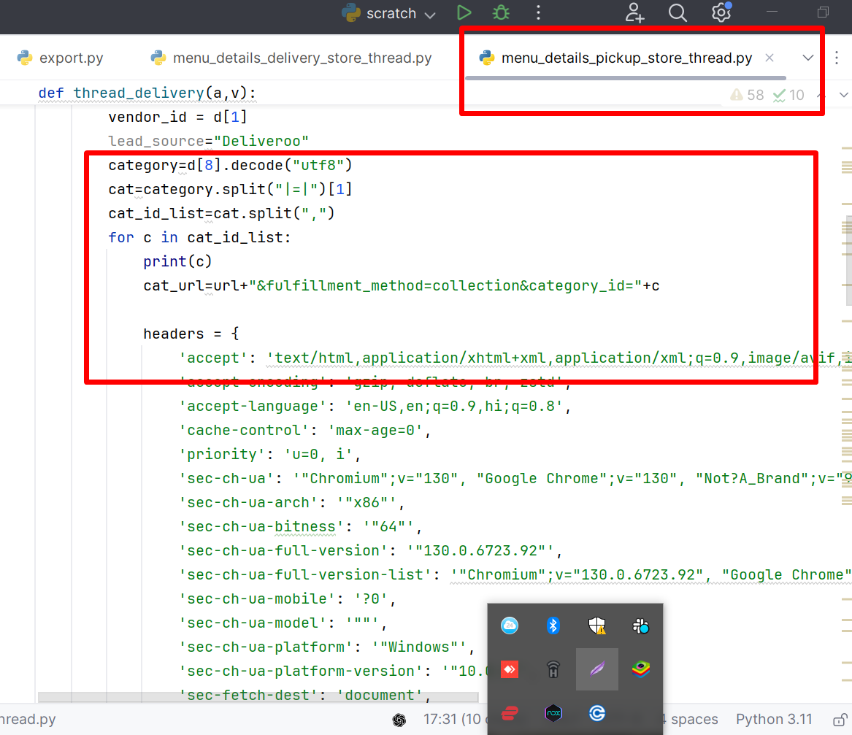
We hit the request to get menu details from store category pickup method

Slide 17
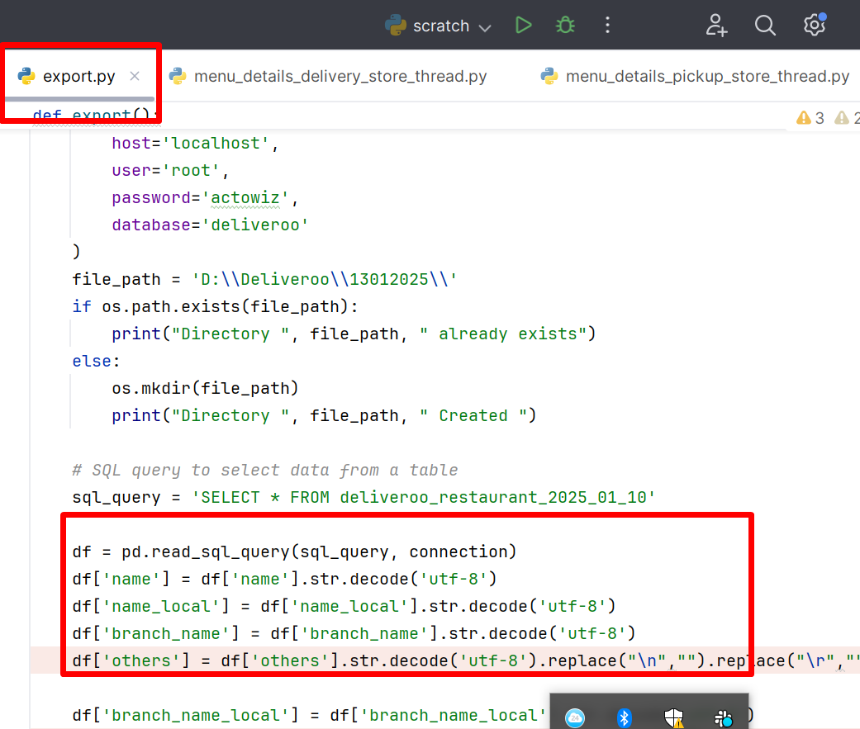
Run this file for export restaurant data file

Slide 18
Execute this query for cleaning and merging dataset in SQL
Before fire this fire Insert ignore query we need to remove Id column from both tables.
1. data_menu_delivery_2024_12_09
2. data_menu_pickup_2024_12_09
Note: Fire below query before we need to remove in both table id column because we are using insert
ignore query.
INSERT IGNORE INTO `data_menu_delivery_2024_12_09` (SELECT * FROM `data_menu_pickup_2024_12_09`)
Create index on “menu_id” in “data_menu_delivery” table.

Slide 19
Hit below query on sql map prices between delivery and pickup table items
UPDATE `data_menu_delivery_2024_10_07` AS p1, `data_menu_pickup_2024_10_07` AS p2 SET p1.`original_price_pickup` = p2.`original_price_pickup` WHERE p1.`menu_id` = p2.`menu_id`;
UPDATE `data_menu_delivery_2024_10_07` AS p1, `data_menu_pickup_2024_10_07` AS p2 SET p1.`discounted_price_pickup` = p2.`discounted_price_pickup` WHERE p1.`menu_id` = p2.`menu_id`;
UPDATE `data_menu_delivery_2024_10_07` AS p1, `data_menu_pickup_2024_10_07` AS p2 SET p1.`discount_price_pickup` = p2.`discount_price_pickup` WHERE p1.`menu_id` = p2.`menu_id`;
UPDATE ` data_menu_delivery_2024_12_09` SET menu_category= REPLACE(REPLACE(REPLACE(menu_category, CHAR(10), ''), CHAR(9), ''), CHAR(13), '');
UPDATE ` data_menu_delivery_2024_12_09` SET menu_items= REPLACE(REPLACE(REPLACE(menu_items, CHAR(10), ''), CHAR(9), ''), CHAR(13), '');

Slide 20
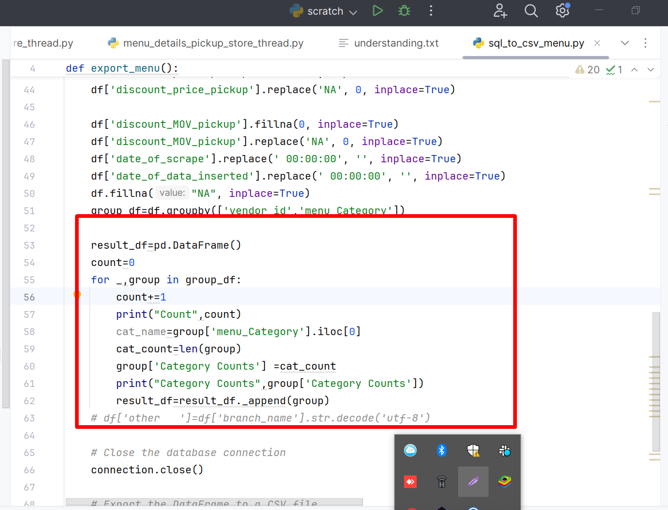
Export menu final file from sql_to_csv_menu.py

Slide 21
For Export menu file comment down highlighted code and export file for QA only after export File uncomment the code and export file for category count column .
Export will take more then 2 days for creating column named categoty count using data frame in csv file

Slide 22
Note:-
Follow all above points and review code before run.
We must check all the table names in code before run the code due to manual intervention in store details and store_menu_details py files .
Lastly check table names and file names before export files.

Slide 23
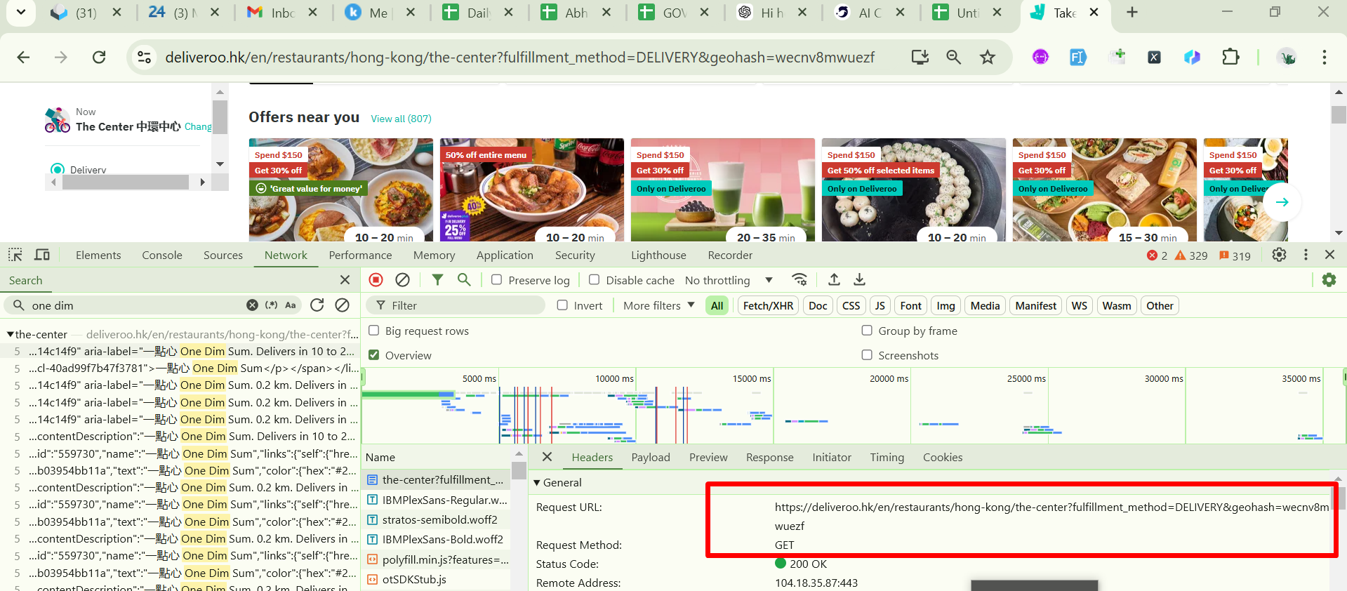
Request for get restaurant’s links Need to pass Geohash and area name for searching

Slide 24
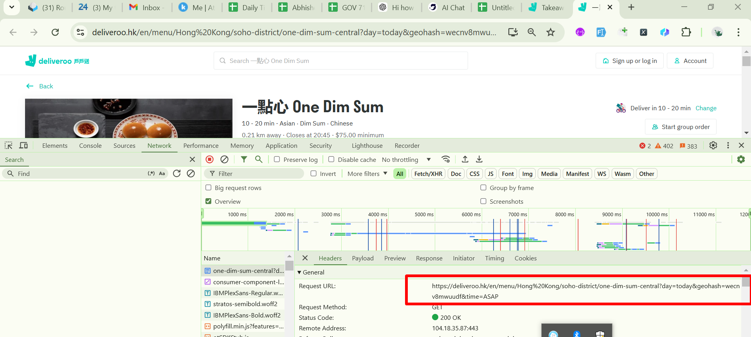
Request for get restaurant data delivery method

Slide 25
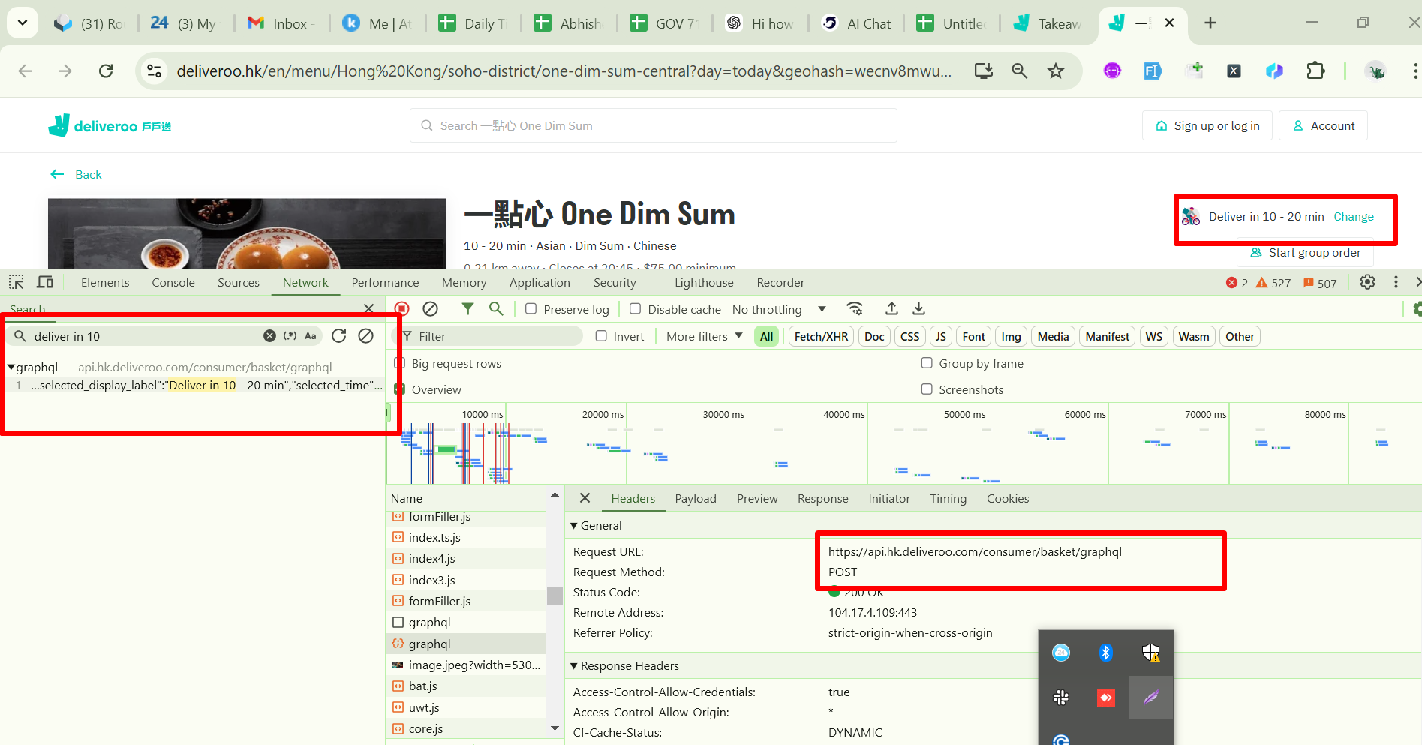
Request to get delivery time

Slide 26
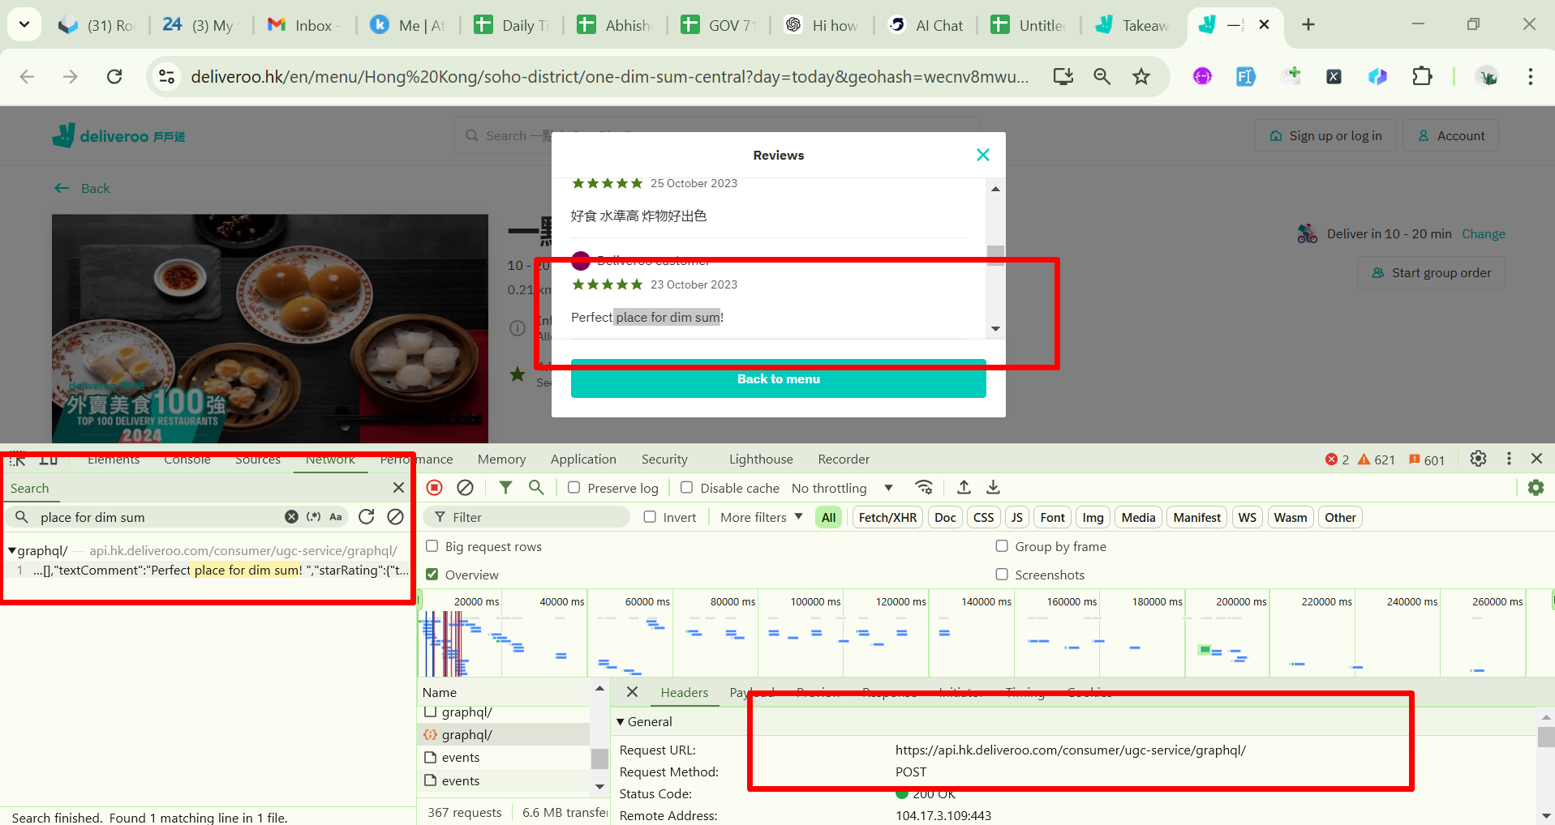
Request for get review count data

Slide 27
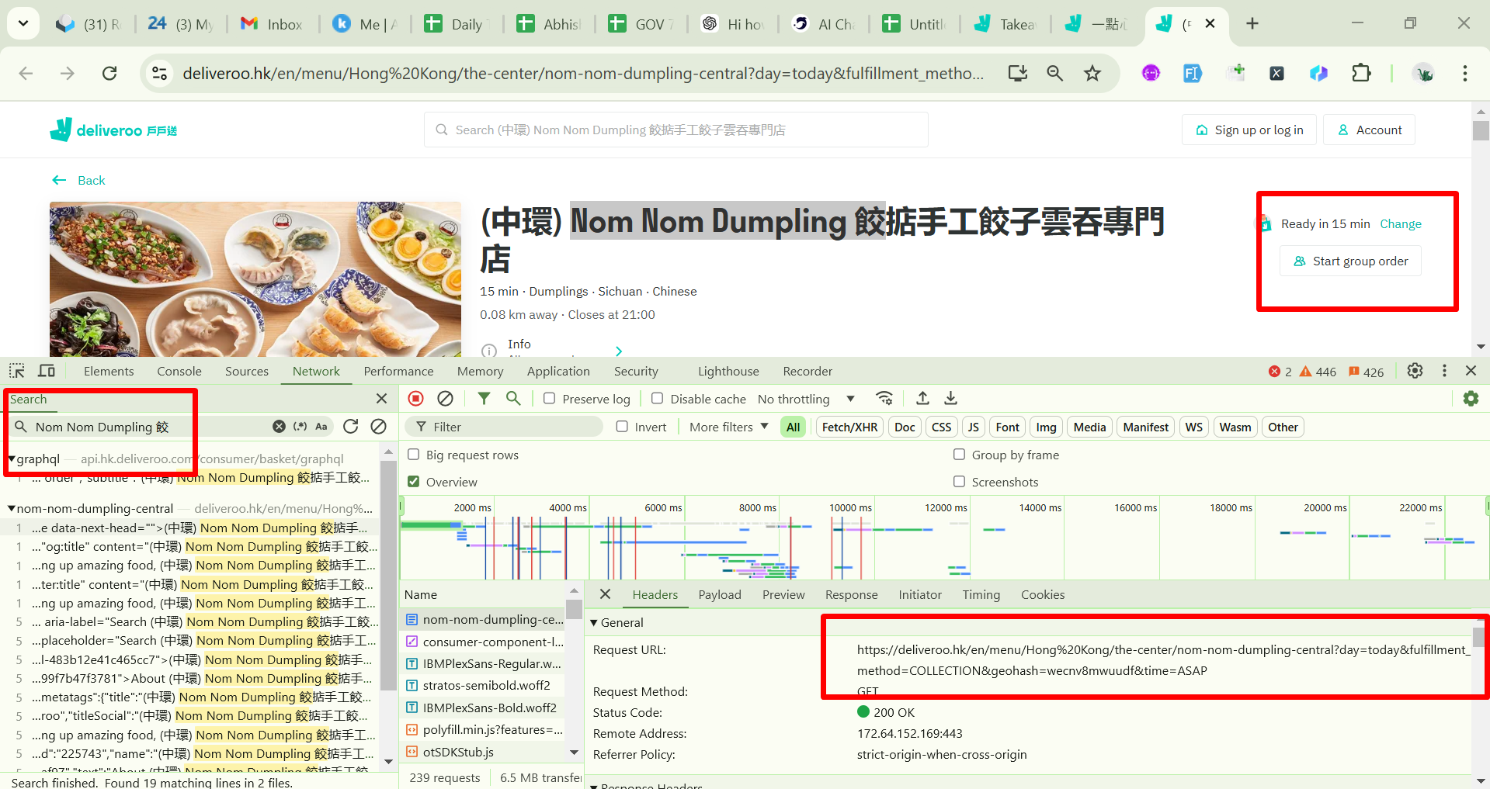
Request for get restaurant data Pickup method

Slide 28
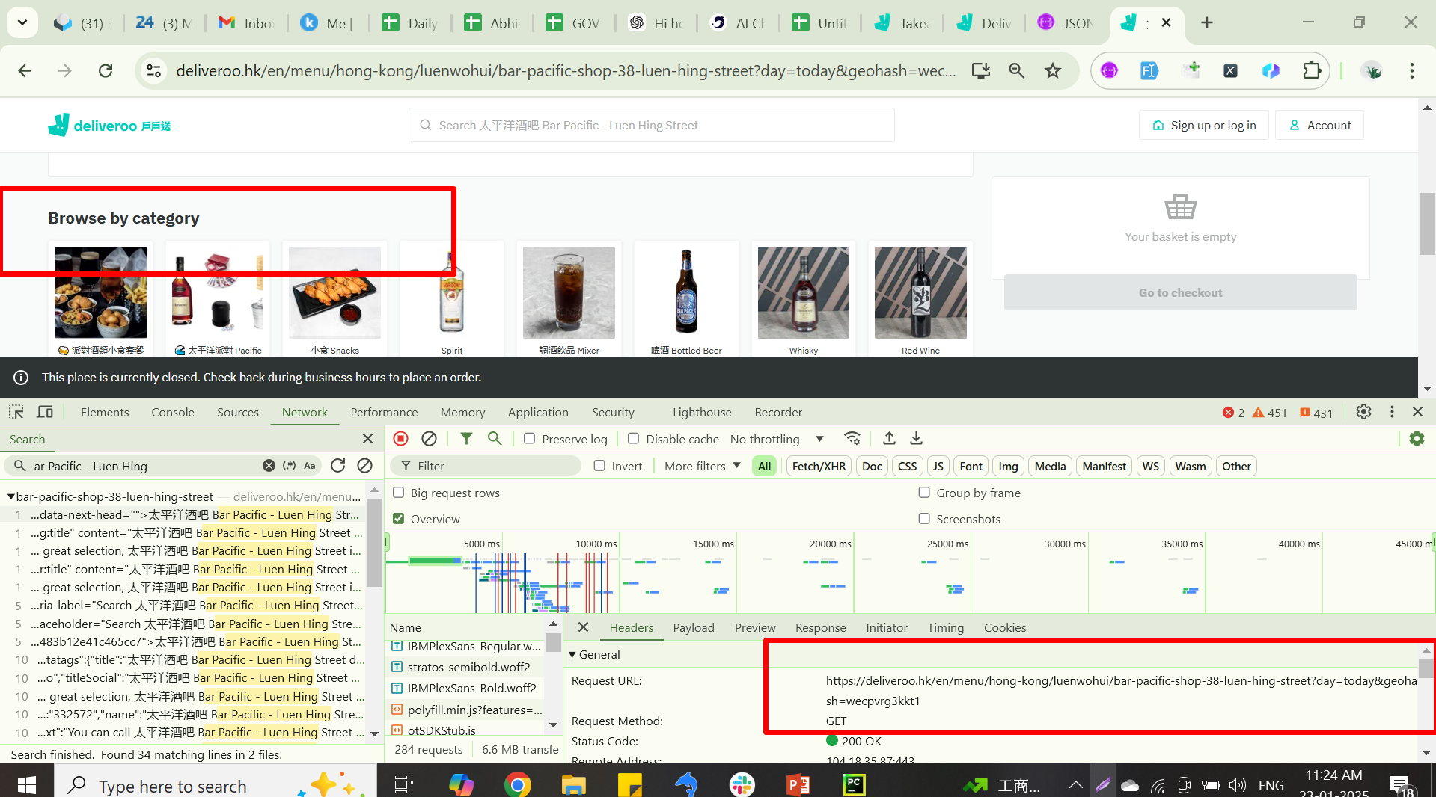
Request to get category data from stores Store is identified with “Browse by category”

Slide 29
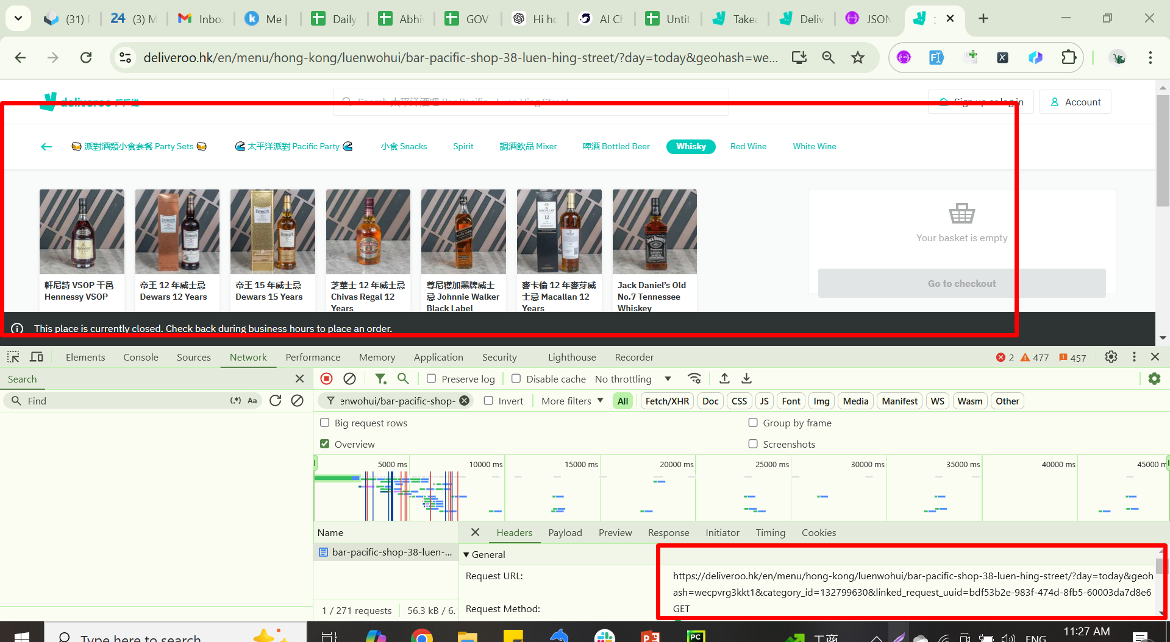
Request to get data for store’s category

